Slide 1








Slide 2
About me
Name : SRINIDHI MUTHYAPU
I have completed my B.Tech. in year 2020 with Electronics & Communication Engineering(ECE).
I’m a fresher, recently graduated .
As a fresher i want to build or start my career in good field where every step is challenging & exciting , where i can learn a lot.
work experience : Fresher
I like about innomatics research labs is that they give time to students to learn and understand what exactly they are learning .
Innomatics Details: SRINIDHI MUTHYAPU-Batch 96
Professional Meet :
Contact : 9502162726 / 7013509429
MAIL ID: srinidhimuthyapu.ips@gmail.com

Slide 3
Project Title
ML - Regression Concrete strength Prediction Project

Slide 4
Agenda
what is ML & TYPES IN ML
what is supervised.
what is project
how it is handled & what have done.
How the algorithms work..
dive deep in project..
how models are performing
which is the best algorithm.

Slide 5
What is ML ???
Machine learning is a method of data analysis that automates analytical model building. It is a branch of artificial intelligence based on the idea that systems can learn from data, identify patterns and make decisions with minimal human intervention.
or
A Computer program is said to learn from Experience (E) with respect to some class of tasks(T) & performance measure (P) , if its performance at tasks (T) as measured by (p) , improves with experience (E).

Slide 6
Types in ML ?
Supervised Learning :
Supervised learning is a process of providing input data as well as correct output data to the machine learning model.
Regression : Output is Numerical
Classification Output is Categorical
UnSupervised Learning :
Unsupervised learning is a type of ml in which the algorithm is not provided with any pre-assigned labels or scores for the training data. As a result, unsupervised learning algorithms must first self-discover any naturally occurring patterns in that training data set.
Clustering
Association
Reinforcement :
It is about taking suitable action to maximize reward in a particular situation. It is employed by various software and machines to find the best possible behavior or path it should take in a specific situation.

Slide 7
Supervised Learning Process flow
Supervised Learning has 2 steps:
Learning (Training ) : Learn a model using training data.
Testing : Test the model using unseen test data to access the model accuracy.
=> In Machine learning , model accuracy is the measurement used to determine which model is best at identifying relationships and patterns between variables in a dataset based on the input, or training, data.
-> Regression;
-> Classification.

Slide 8
Linear Regression
Linear Regression :
Regression models a target prediction value based on independent variables.
It is mostly used for finding out the relationship between variables and forecasting. Different regression models differ based on – the kind of relationship between dependent and independent variables, they are considering and the number of independent variables being used.
In simple words performing the best suitable line
x: Input training data (univariate – one input variable(parameter))
y: labels to data (supervised learning)

Slide 9
What is project
This project is based on supervised learning - Regression based project .
data on :
ML - Regression Concrete strength Prediction Project
Aim :
Understand the algorithms how it is working , what best can we do

Slide 10
Project : ML - Regression Concrete strength Prediction Project
Performed models :
1. Linear Regression - regression technique
2. Regularisation techniques :
i) Ridge (L2)
ii) Lasso (L1)
3. Decision Tree - both regression & classification can perform
4. Random Forest - both regression & classification can perform
5. KNN - both regression & classification can perform
6. SVM - both regression & classification can perform

Slide 11
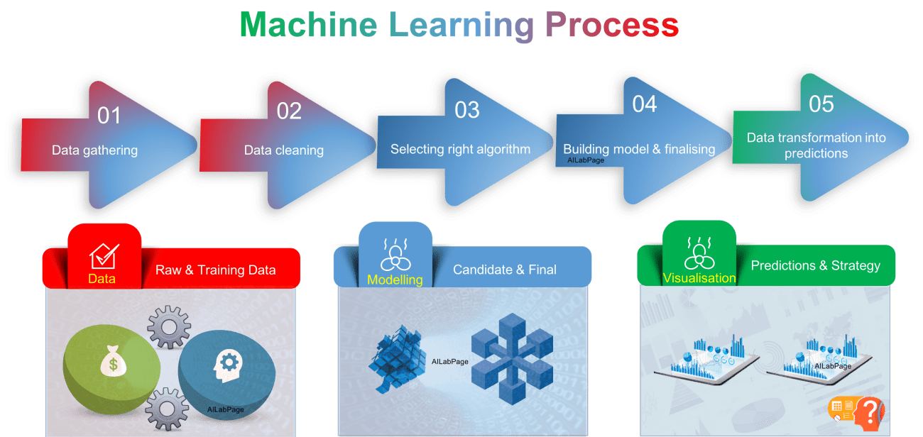
Machine Learning process:
Data Gathering
Data Cleaning
removing unwanted observations
dealing with missing data
dealing with outliers
structural error solving.
Selecting right algorithm
Building model and finalising
Data transforming into predictions.

Slide 12
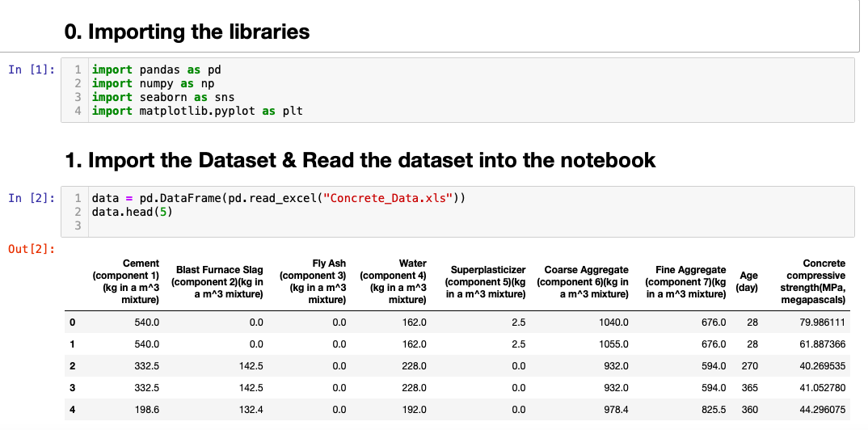
Step 1:
Importing basic libraries:
import pandas as pd
import numpy as np
import seaborn as sns
import matplotlib.pyplot as plt.
importing data set:
data = pd.DataFrame(pd.read_excel("Concrete_Data.xls"))
data.head(5)

Slide 13
step 2 - Basic understanding of dataset
1. Shape of data.
2. List out the feature variables and their data-types.
data.info
data.describe()
changing the column names if necessary for easy understanding.

Slide 14
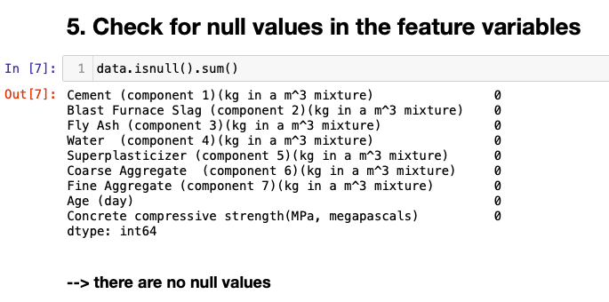
step 3 - Data Cleaning
3.1. Dealing with null values :
The real-world data often has a lot of missing values. The cause of missing values can be data corruption or failure to record data. The handling of missing data is very important during the preprocessing of the dataset as many machine learning algorithms do not support missing values.

Slide 15
-> Which models to be performed :
Base model can be == only those which can perform reg techniques like
Linear = regression technique
Log = classification technique
KNN = both regression & clasification can perform
Decision tree = both regression & clasification can perform
Random forest = both regression & clasification can perform
For regression:
from sklearn.neighbors import KNeighborsRegressor
from sklearn.tree import DecisionTreeRegressor
from sklearn.ensemble import RandomForestRegressor

Slide 16
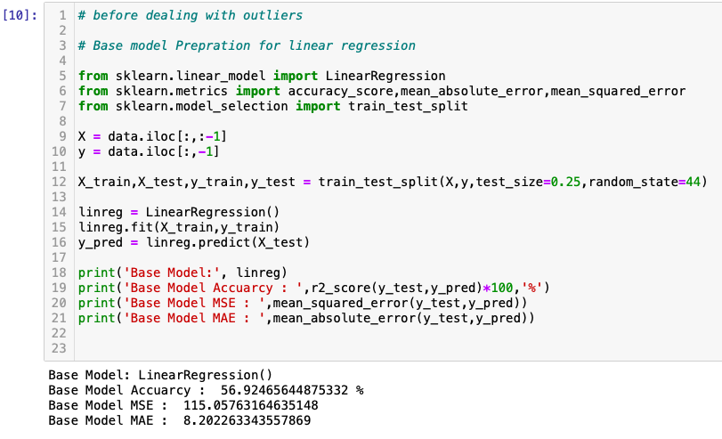
Before dealing with outliers lets check the Accuracy , RMSE & MSE of those models .
Root Mean Square Error is the measure of how well a regression line fits the data points. RMSE can also be construed as Standard Deviation in the residuals.
RMSE = np.sqrt(mse(y_test,y_pred_Lin_reg)).
RMSE = 5
MSE = 25

Slide 17
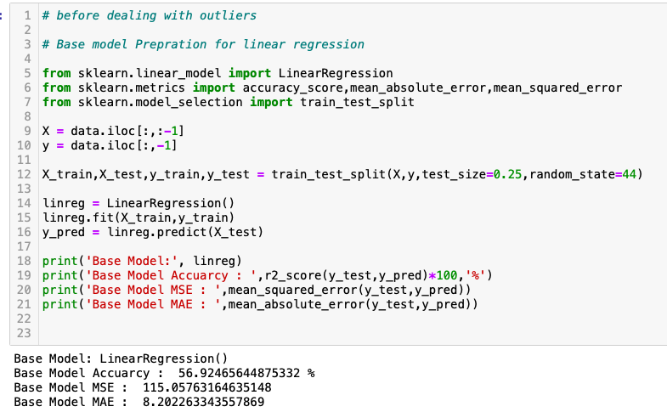
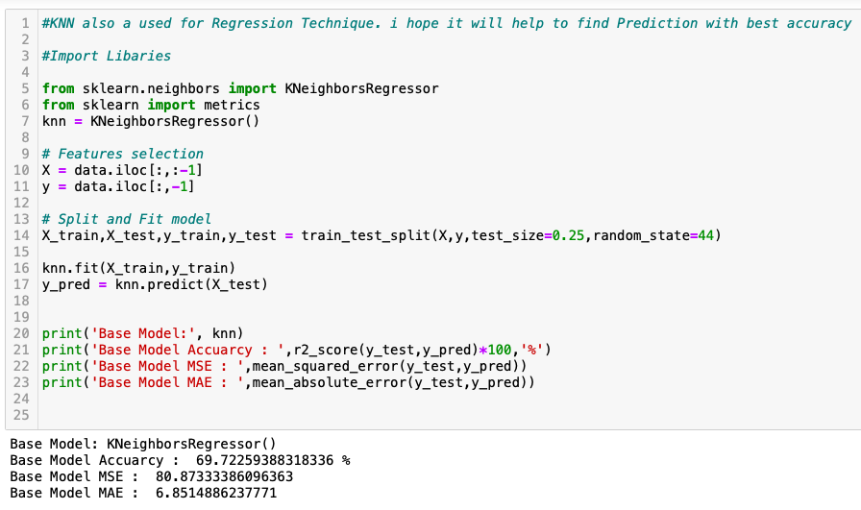
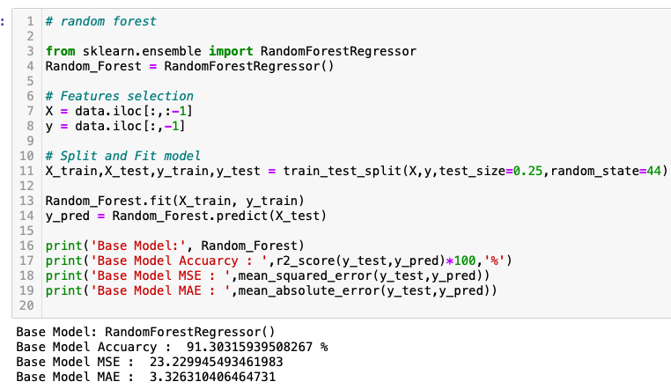
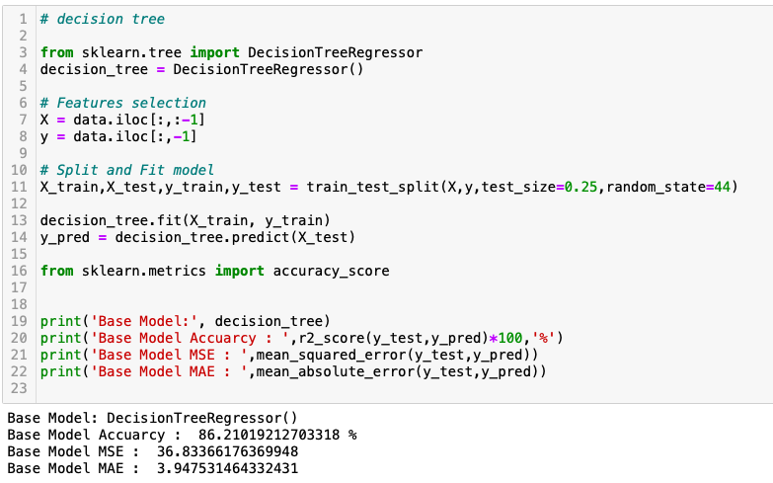

Slide 18
Observations on reg models before dealing with outliers:
Base Model: LinearRegression()
Base Model Accuarcy : 56.92 %
Base Model MSE : 115.1
Base Model MAE : 8.20
Base Model: KNeighborsRegressor()
Base Model Accuarcy : 69.72 %
Base Model MSE : 80.87
Base Model MAE : 6.85
Base Model: DecisionTreeRegressor()
Base Model Accuarcy : 85.8%
Base Model MSE : 37.93
Base Model MAE : 4.1
Base Model: RandomForestRegressor()
Base Model Accuarcy : 90.98 %
Base Model MSE : 24.1
Base Model MAE : 3.34
From this, since the data has less outliers the result in decision tree, random forest are good & lets compare them after removing/dealing with outliers.
-> But to get good accuracy we need to deal with outliers and perform the model again ......
-> If ur model has good accuracy then ur model is good
-> we did the above base model for test set only in (linear, knn, DT, RF) not focussed on train set after removing outliers we can check both train & test to know wheather the model is overfitting or underfitting.

Slide 19
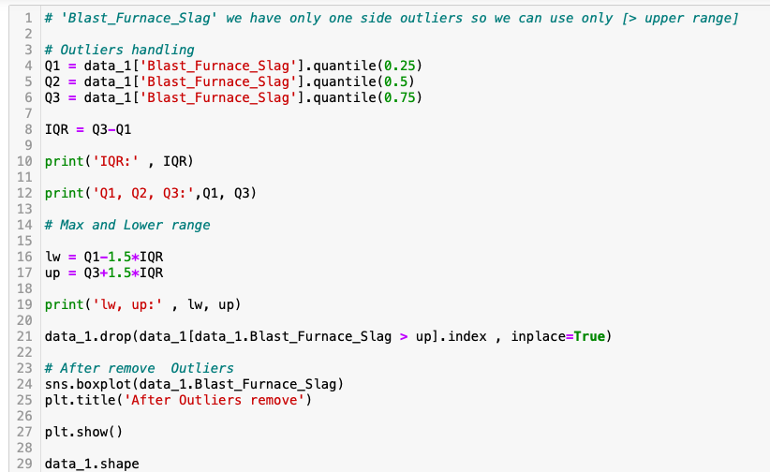
3.2. Dealing with Outliers :
An outlier may indicate bad data.
It is important to deal with outliers, becks after complete removal of outliers we get the model accuracy high . if the acc of model is high then it is simply good model.
Lets check which model gives good performance before dealing with outliers which is base model & after dealing with outliers. ..????…
to check the outliers easy way is box-lot:
for i in data_1.columns:
sns.boxplot(data_1[i])
plt.show()

Slide 20
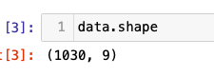
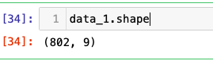
check the shape of data after removing the outliers:
-> data = raw data
-> data_1 = data after cleaning
i.e., after removing null values & outliers
=> Outliers are removed now, it also has no null values , now the dataset is cleaned , good for further experiments ......
==> Lets check after removing outliers what is the accuracy of above models

Slide 21
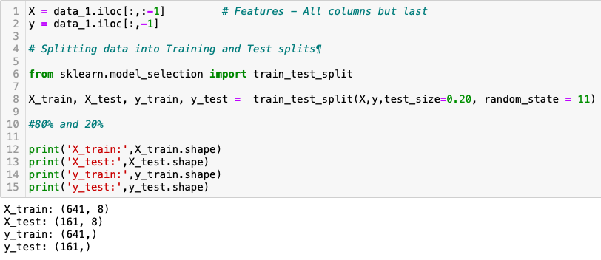
Splitting the data set :

Slide 22
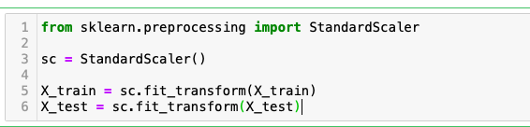
Observations:
Feature Scaling - We do scaling of data for balancing the data points.
The most common techniques of feature scaling are Normalization and Standardization.
Normalization is used when we want to bound our values between two numbers, typically, b/w [0,1] R [-1,1].
While Standardization transforms the data to have zero mean and a var of 1, they make our data unitless.

Slide 23
Note:
Lets check wheather model is Over-fitting or Under-fitting.........
Over-fitting = it consider each and every single point(even noise)
Under-fitting = which doesnot fit the data well enough.
If ur train-set accuracy is higher than test-set accuracy = over-fitting.
lets check it by performing train-set & test-set like - X_train , X_test.
Here we can ignore the difference less than 10 becks the difference between them(test & train) is not that high , if the case is less than 10 then we can consider it as good - not over-fitting / under-fitting.

Slide 24
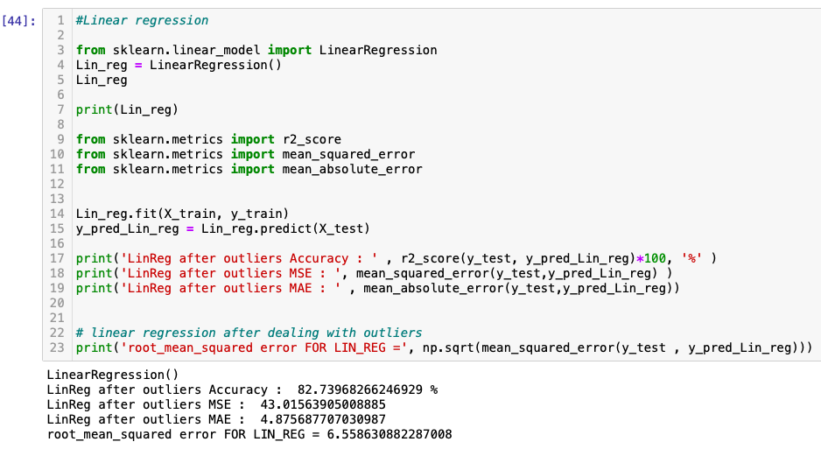
After removing outliers the result of linear reg:
LinearRegression()- for cleaned data
LinReg after outliers Accuracy : 82.74 %
LinReg after outliers MSE : 43
LinReg after outliers MAE : 4.87
Root_mean_squared error FOR LIN_REG = 6.6
After removing outliers the accuracy of linear reg is hignly increased .
so after dealing with small amount of outliers also result will be very good.
Linear_reg before outliers:
Base Model: LinearRegression()
Base Model Accuarcy : 56.92 %
Base Model MSE : 115.1
Base Model MAE : 8.20
As we can see there is " highly change in Accuracy" we can also check "RMSE"
-> RMSE = np.sqrt(mse(y_test,y_pred_Lin_reg)).

Slide 25
models of cleaned data set observe the acc
LinearRegression()
for test set:
test_Acc_for_Lin_reg : 82.74 %
test_MSE_for_Lin_reg : 43
test_MAE_for_Lin_reg : 4.87
test_RMSE FOR LIN_REG = 6.56
for train set:
train_Acc_for_Lin_reg : 78.99%
train_MSE_for_Lin_reg : 48.74
train_MAE_for_Lin_reg : 5.33
train_RMSE FOR LIN_REG = 6.98
Ridge()
for test set:
test Ridge reg Acc : 82.74 %
test Ridge reg MSE : 43.01
test Ridge reg MAE : 4.88
test Ridge reg RMSE = 6.56
for train set:
train Ridge reg Acc : 78.99 %
train Ridge reg MSE : 48.74
train Ridge reg MAE : 5.32
train Ridge reg RMSE = 6.98
Lasso()
for test set:
test Lasso_reg_Acc : 82.76%
test Lasso_reg_MSE : 42.965
test Lasso_reg_MAE : 4.88
test_RMSE FOR Lasso_reg = 6.55
for train set:
train Lasso_reg_Acc : 78.97 %
train Lasso_reg_MSE : 48.79
train Lasso_reg_MAE : 5.3
train_RMSE FOR Lasso_reg = 6.98

Slide 26
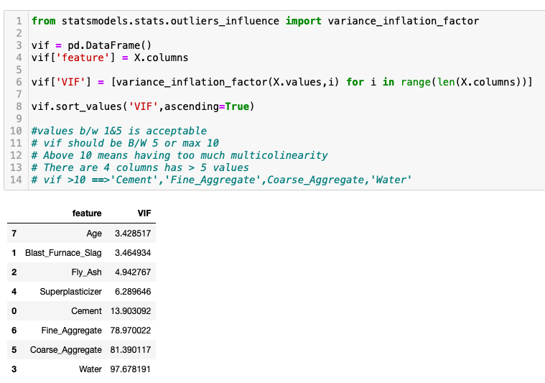
IN Linear regression:
VIF : Variance inflation factor
It measures how much the behaviour (variance) of an independent variable is influenced, or inflated, by its interaction/correlation with the other independent variables.
vif allow a quick measure of how much a variable is contributing to the standard error in the regression.
In VIF values b/w 1&5 is acceptable
VIF should be B/W 5 or max 10
Above 10 means having too much multicollinearity

Slide 27
Observations:
There is difference after removing those 4 columns so, lets check in OLS summary..
However it is clear that if 'vif' value is high then those cols are not much worthy/weightage
vif = high , then those are having high multi-colinearity …
VIF means is a measure of the amount of multicolinearity among the independent variable in a set of multiple regression variable.
A large VIF (varience inflation factor) means highly correlation between the independ features.
A variance inflation factor is a tool to help identify the degree of multicollinearity
Multicollinearity creates a problem in the multiple regression because the inputs are all influencing each other. Therefore, they are not actually independent, and it is difficult to test how much the combination of the independent variables affects the dependent variable, or outcome, within the regression model. In statistical terms, a multiple regression model where there is high multicollinearity will make it more difficult to estimate the relationship between each of the independent variables and the dependent variable.
Note : For the data, if VIF will greater then to the 10 then we have to remove those column. becuase in these column high Varience or VIF.
let’s perform the old model before and after & before those 4 cols removed.

Slide 28
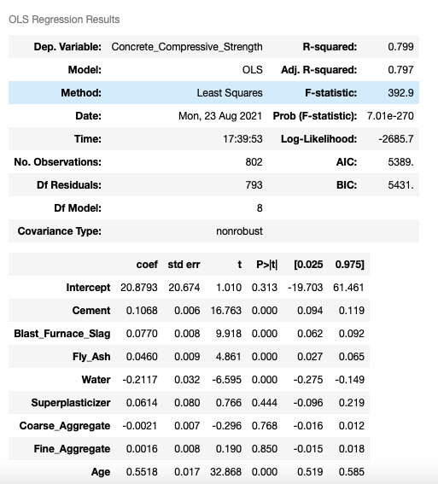
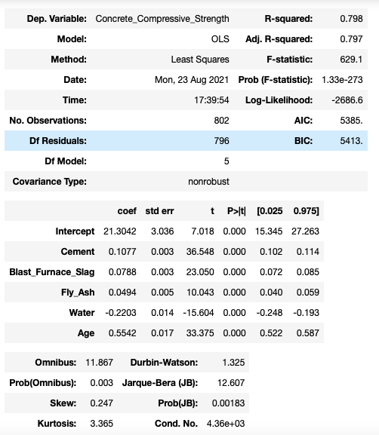
OLS result of cleaned data & 2nd is after removing those 4 col’s which having high multi-collinearity

Slide 29
Observations :
there isn’t much difference after removing those col’s . so, we can tell that those are not that important columns to dataset .
OLS(Ordinary Least Squares) least squares method for estimating the unknown parameters in a linear regression model.
And in OLS we have to check R2, adj R2 & p-value.
in above , 1st ols-model is having all cols & 2nd ols-model the col’s which are having high p-value in 1st ols are removed and remained only 5 col’s.
but here after removing those columns also the r2 value is not changed.
we can also perform Forward Selection & Backward Selection for clear understanding.

Slide 30
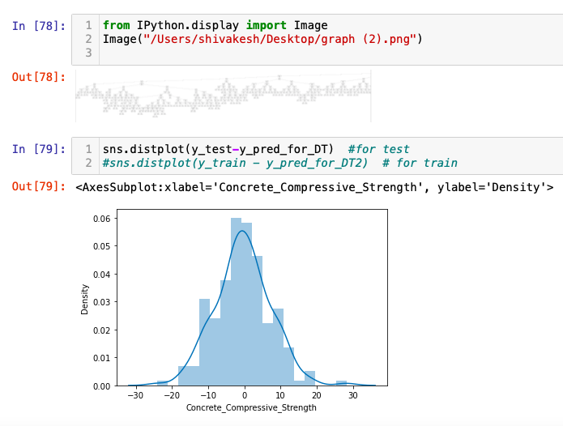
Result in Decision tree
for test:
test_Acc : 88.6 %
test_MSE : 31.2
test_MAE : 3.7
test_RMSE : 5.6
for train:
train_Acc : 99.46 %
train_MSE : 1.26
train_MAE : 0.10
train_RMSE : 1.12
here in Decision Tree , here train acc is higher than test acc that means this model is over-fitting.
But here the difference between them is also not much high just the diff of 11 .
if tehre is a case like the diff is having above 20 or 15 those are considered as overfitting/underfitting.
lets , check the rest and compare the differences...

Slide 31
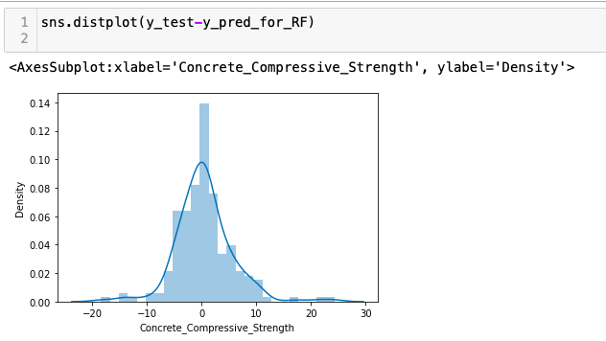
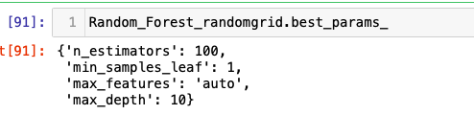
Result in Random Forest
RandomForestRegressor(n_estimators=10)
for test:
test_Accuarcy : 89.23 %
test_MSE : 26.9
test_MAE : 3.56
for train :
train_score : 97.29 %
train_MSE : 6.234
train_MAE : 1.59
train RMSE: 1.26
here in Random Forest , here train acc is higher than test acc that means this model is Over-fitting.
But here there is no much diff like its only 8% so it is not that over-fitting.
We can also perform hyper-parameters , these are the best parameters in random-forest..

Slide 32
Result in knn(k - Nearest Neighbour)
KNN is a simple supervised learning algorithm .
it solves both regression & classification techniques.
it is known as lazy-learner.
it is also used for image processing by converting 3-D to 1-D vector and use the same as input to knn.
it doesn’t learn any values / variables but instead it calculate the distance every time.
distance = Manhattan , minkowski , euclidien
Model: KNeighborsRegressor()
for test:
test_score : 64.31 %
test_MSE : 82.89
test_MAE : 6.98
test_RMSE: 9.10
for train:
train_score : 76.1 %
train_MSE : 56.6
train_MAE : 5.75
train_RMSE: 7.5
the difference between both are only 12% so we can/cannot consider these as overfitting . but becoz of the diff is less than 15% in each model we are performing lets not say we consider it as overfitting..

Slide 33
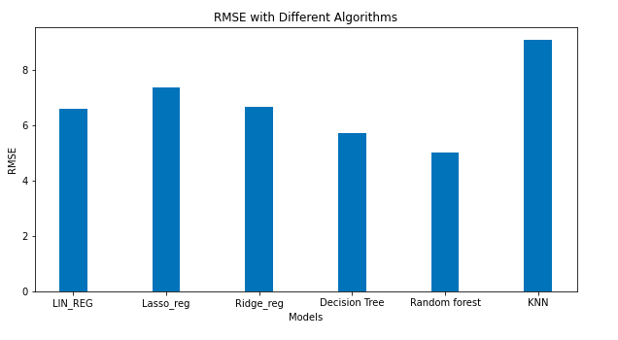
Observations :
These are the RMSE of the models which are performed :
test_RMSE FOR LIN_REG = 6.68
test_RMSE FOR Lasso_reg = 7.37
test RMSE for Ridge_reg = 6.67
test_RMSE for Decision Tree : 5.74
test_RMSE for Random forest : 5.024
test_RMSE for KNN : 9.10
Lower values of RMSE indicate better fit.

Slide 34

Conclusion:
ACCURACY’s of all models
Lin_reg : 82.74 %
Lasso_reg : 82.76 %
Ridge reg : 82.74%
Decision tree : 86.57 %
random_forest : 89.2 %
knn : 64.30 %
This project main aim is to understand how we are performing the algorithms and what can we change , which method we are performing. what other methods we can also perform ..
Finally all models are having good accuracy and performing well .
Random Forest is the best model.

Slide 35

THANK YOU

